Slide 1

What is TFIDF?

Slide 2


Slide 3
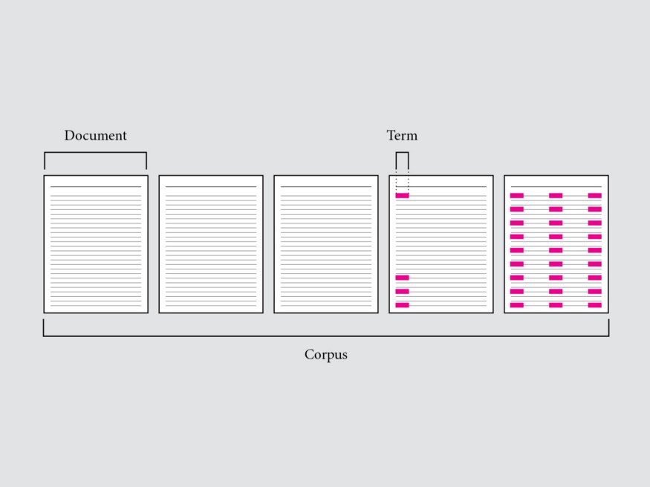

Slide 4
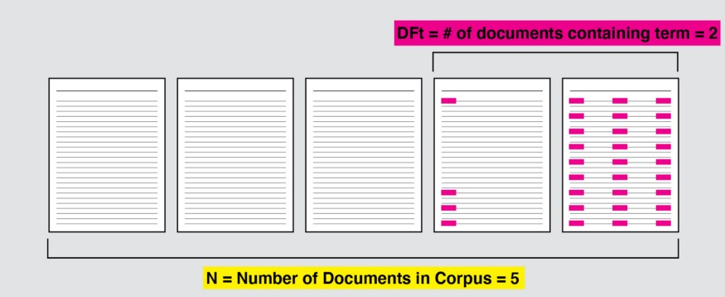
IDF = log(Number of docs containing this term / Number of documents)

Slide 5
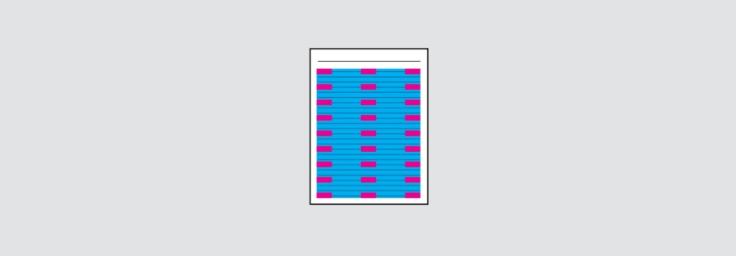
TF = (frequency of this word in this doc / Number of words in this doc)

Slide 6
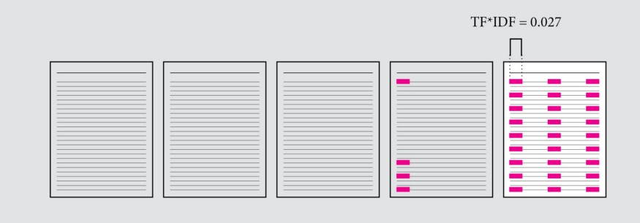
TF-IDF score = TF * IDF

Slide 8
Resources :
https://towardsdatascience.com/tf-idf-a-visual-explainer-and-python-implementation-on-presidential-inauguration-speeches-2a7671168550
https://en.wikipedia.org/wiki/Tf%E2%80%93idf
https://scikit-learn.org/stable/modules/generated/sklearn.feature_extraction.text.TfidfVectorizer.html
https://monkeylearn.com/blog/what-is-tf-idf/

